Slide 1

Interactive Web Application:
WHODAT (Designed for:
Developed by: Lily Dourlain, Brandon Gordon, Wes Miller, and Declan Kelly
Notes:
Wes will open up and introduce the project

Slide 2
Problem: Data access, and interactivity
The World Health Organization (henceforth known as WHO) has an incredible amount of data on all manner of health topics covering most countries in the world (194 to be exact). WHO presents data based on different themes but often times specific information is difficult to find or confusing when you find it, and not very interactive.
Notes:
Wes will continue from his last slide (project introduction) to the first paragraph of this slide
Declan can start reading the second paragraph and go into the video clip on the next page

Slide 3
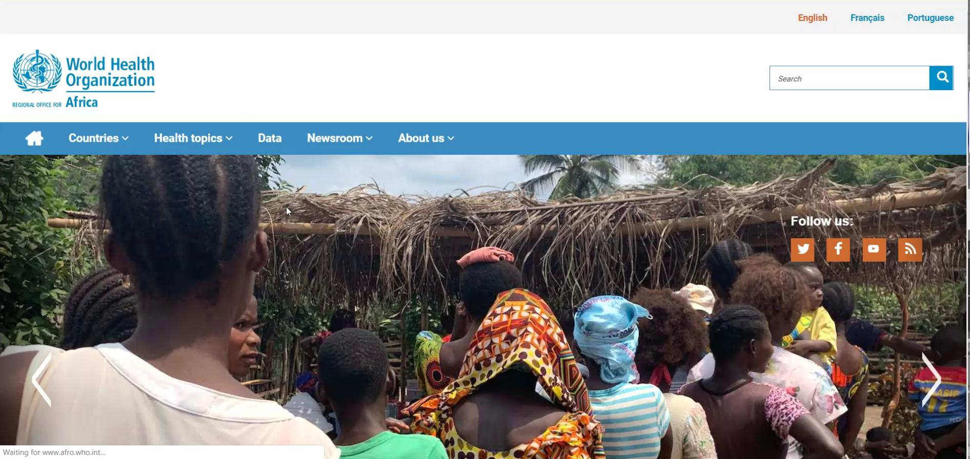
Confusing Site Design
Notes:
Declan will continue his explanation from the last page into this to help describe the confusion

Slide 4
Solution: Interactive Web App w/ Map
WHO covers the entire globe but information focuses on specific topics. We provide an app that can filter your results for these specific topics based on key indicators and categories accessed through WHO’s API.
WHO employs the use of continent specific sub-domains, which increases complexity for an average user to navigate around the globe for information. We provide a map for easier navigation to different information around the globe that doesn’t require navigating to other pages to find it.
Notes:
Lily covers this slide and follows up with the opening for the site demo

Slide 5
WHODAT Site Demo
http://localhost:8080
Notes:
Lily will open up the demo because she was covering the last slide, but we can all ad lib during the site demo unless we work out a specific plan

Slide 6
Key Technologies Employed
MySQL - Database used to relate Countries and Indicators with IndicatorValues
Node.js - The server that would be making the API calls to retrieve data from WHO
Node-schedule: Updates frequently used indicators every day at midnight
HTML5 / CSS - Site visuals and skeleton/structure
Bootstrap was also used to assist with site visuals/responsiveness
JavaScript - Used jQuery and D3js to create an interactive user experience
Ajax & JSON - Used AJAX and JSON to communicate between Node, Database, and WHO API
Notes:
Brandon will run through the list of key technologies and why we used them

Slide 7
Questions?
We have answers

